Slide 1
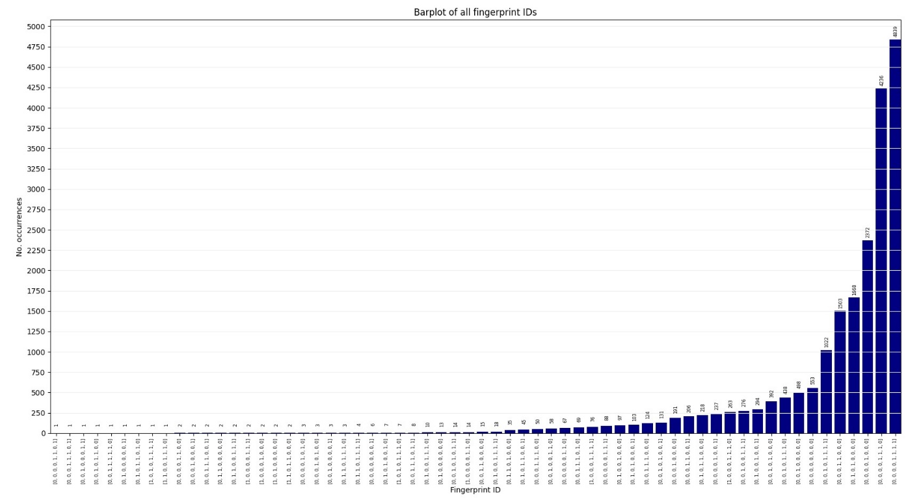

Slide 2
Structure Predictions
Web-server options for structure predictions
OpenFold
ColabFold
AlphaFold Database

Slide 3
Structure Predictions
Web-server options for structure predictions
OpenFold
Good for structure prediction with low-coverage/shallow sequence alignments
Open access to AlphaFold prediction modelling
Web server did not function (error thrown server-side in running the notebook)
Took 1-2 hours to run a multiple sequence alignment before the error, cannot see batch function
ColabFold
Fast, accurate, could select AlphaFold model (multimer model)
Gives additional read-outs like pLDDT and PAE plots
Custom multiple sequence alignment option available BUT
Alignment I have not appropriate
Reached GPU usage limit fairly quickly (after a few structure predictions)
Couldn’t get batch notebook to run (space issue?)
AlphaFold Database
Pre-computed structures
API available for download (4,776/20,304 sequences had a structure)
Structures generally poor quality (low pLDDT for anything outside the amidase_3 core structure, in several cases the amidase_3 structure had a large number of residues with pLDDT <70) – structures produced in 2022, using monomer model, most of the AmiC proteins contain multiple domains

Slide 4
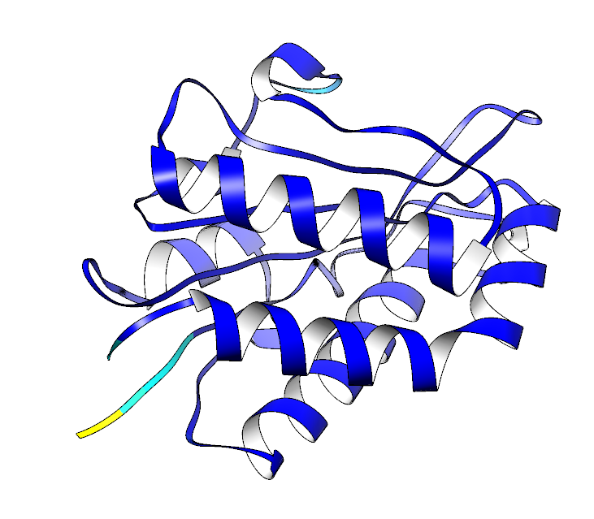
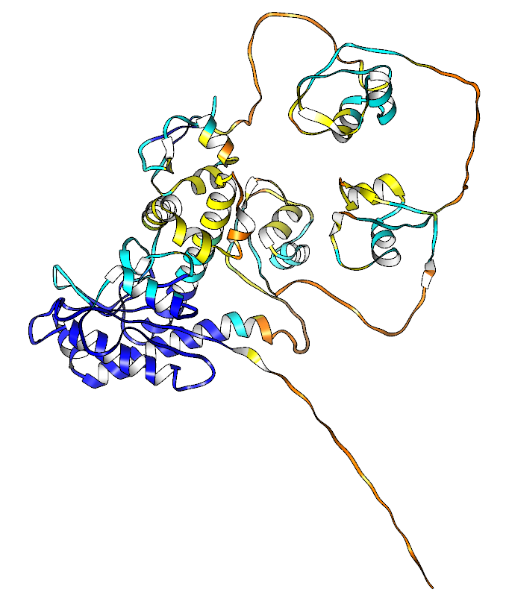
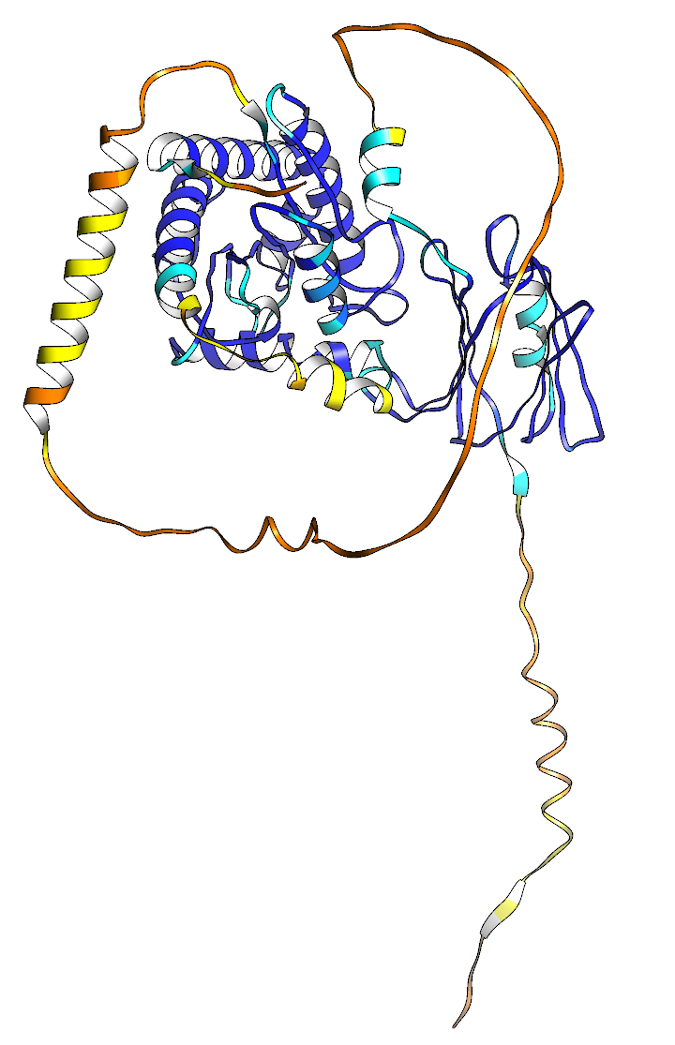
Structure Predictions (AlphaFold DB)
Sphingobacterium mizutaii, cluster group 00000000
Duganella sp., cluster group 00001111
Pasteurellaceae bacterium, cluster group 00001110

Slide 5
Structure Predictions
Web-server options for structure predictions
OpenFold
Good for structure prediction with low-coverage/shallow sequence alignments
Open access to AlphaFold prediction modelling
Web server did not function (error thrown server-side in running the notebook)
Took 1-2 hours to run a multiple sequence alignment before the error, cannot see batch function
ColabFold
Fast, accurate, could select AlphaFold model (multimer model)
Gives additional read-outs like pLDDT and PAE plots
Custom multiple sequence alignment option available BUT
Alignment I have not appropriate
Reached GPU usage limit fairly quickly (after a few structure predictions)
Couldn’t get batch notebook to run (space issue?)
AlphaFold Database
Pre-computed structures
API available for download (4,776/20,304 sequences had a structure)
Structures generally poor quality (low pLDDT for anything outside the amidase_3 core structure, in several cases the amidase_3 structure had a large number of residues with pLDDT <70) – structures produced in 2022, using monomer model, most of the AmiC proteins contain multiple domains
AlphaFold v3
Webserver available
Predictions seemed comparable to ColabFold even for multimers
Paper shows results comparable/improved for structure prediction over AlphaFold v2
20 structure per day prediction limit
Cannot change/access parameters (eg multiple sequence alignment, seed number)

Slide 6
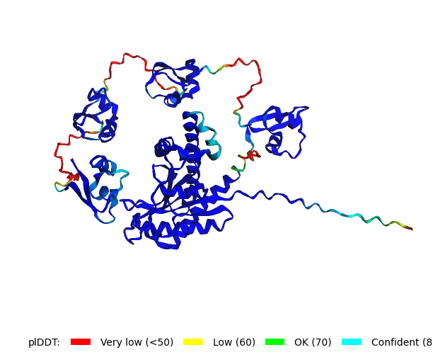
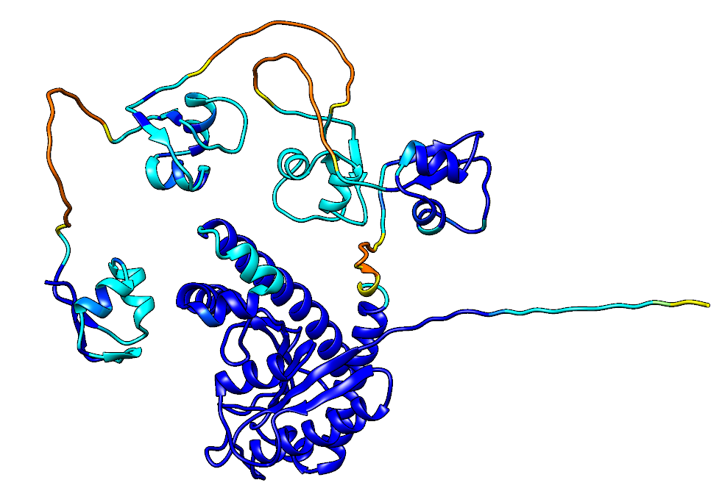
Structure Predictions
AlphaFold Protein Structure Database
ColabFold (multimer prediction model)
AlphaFold v3
Pasteurellaceae bacterium, cluster group 00001110
Notes:
AlphaFOld v3 is less confident in its prediction, but produces the same structural arrangement and domain predictions as colabFold; considered since the GPU limit was reached really quickly per day for ColabFold and I could do batches of 20 per day for AlphaFold v3, that the slightly lower confidence was an acceptable compromise given the structural similarities (and good prediction for the amidase_3 region)

Slide 7
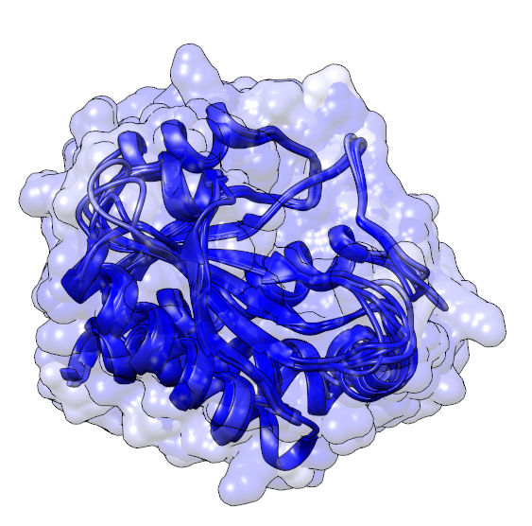
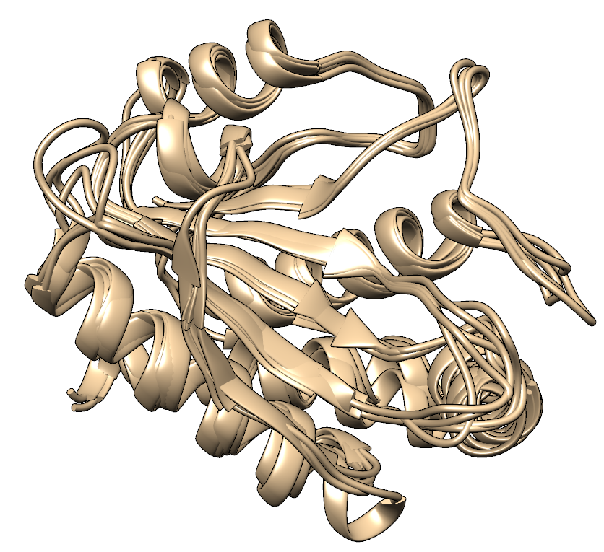
Cluster 00000000 (no insertions predicted)
Looked at the top 10 fingerprint groups in the sequence dataset (random selection of 5 sequences from each group and predicted structure using AlphaFold v3)
Notes:
Made sure the amidase_3 core predictions were high quality (pLDDT for residues >90) as is the case for the 00000000 cluster amidase_3 domain

Slide 8
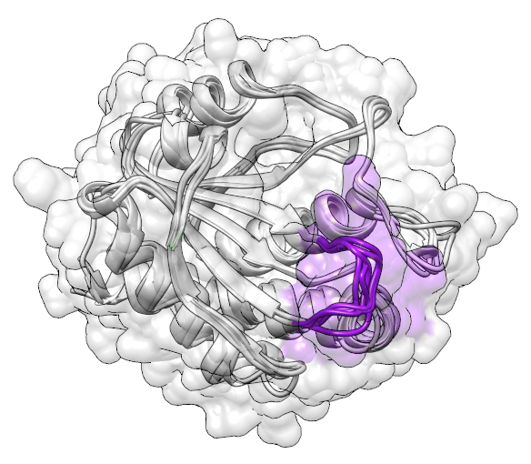
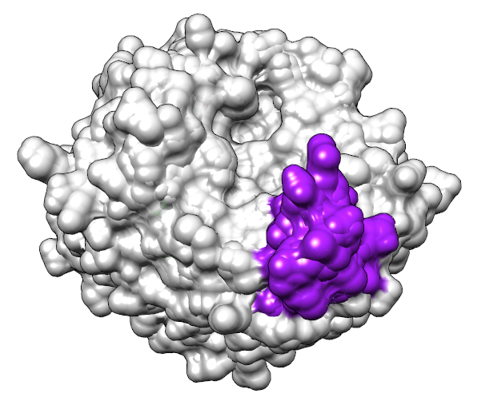
Cluster 00001000 (I-5 only)
Loop region position at the ‘lip’ of the active site entrance.
A loop is present in all structures predicted, however the loop is extended in structures identified to have an ‘I-5’ insertion.

Slide 9
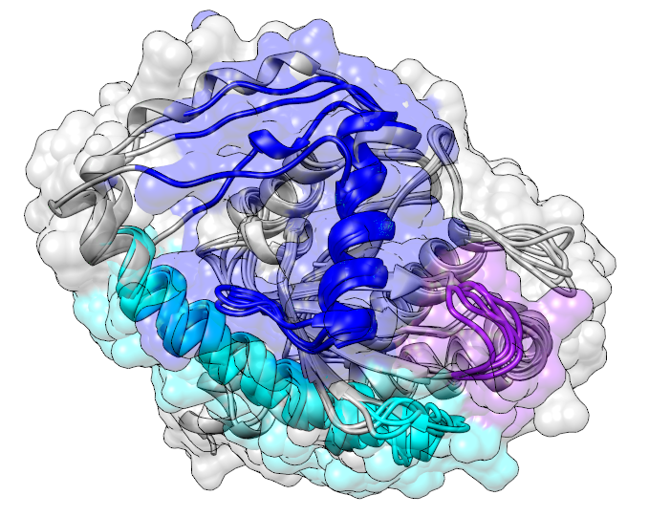
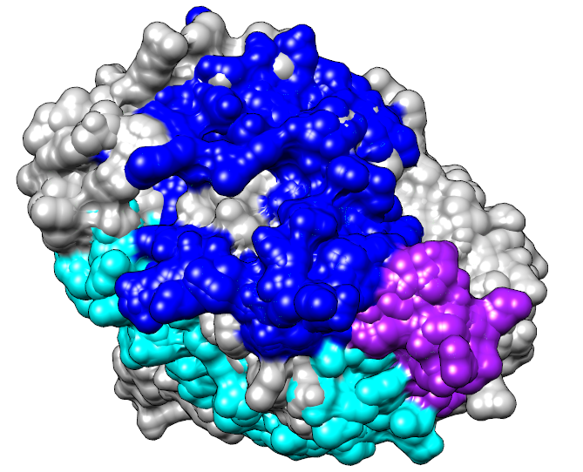
Cluster 00001110 (I-5, I-6, I-7)
I-6: Novel helix added to ‘block’ the active site
I-7: Extension to an existing helix, possibly to accommodate I-6 (I-6 rarely seen without I-7 in the fingerprints seen in the dataset)
Where I-6 and I-7 (both alpha helices) are also present, the I-5 loop folds to form a ‘block’ which overlaps with the space I-6 and I-7 take up, effectively blocking the active site

Slide 10
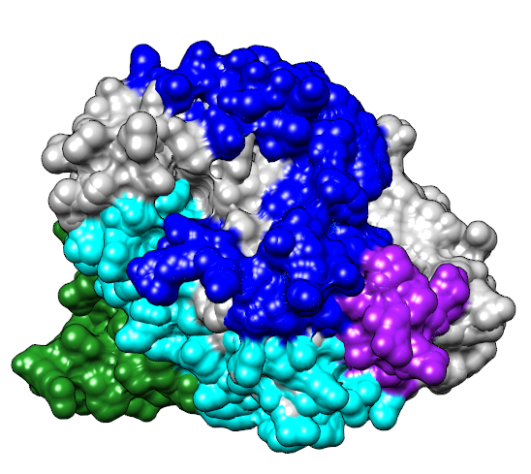
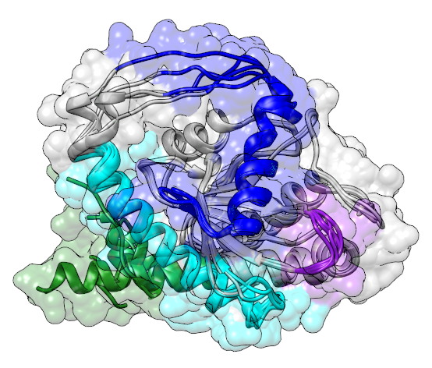
Cluster 00001111 (I-5, I-6, I-7, I-8)
I-8: Extension to existing helix
Given that I-8 corresponded to an extension of the end of the protein structure and was not associated with any phyla in particular, it is plausible that this is not a true evolutionary insertion, but rather an artefact of domain boundary assignation, where some sequences retained the full helix after being cropped to amidase_3, and others had the end of the helix removed.
Notes:
I-1 was not common within the dataset, and appeared only alongside other insertions. To investigate this insertion, one gram-positive structure (from Lysinibacillus halotolerans, I-1 and I-5 insertions) and one gram-negative structure (from Rodentibacter pneumotropicus, I-1, I-6 and I-7 insertions) were selected for prediction. These structures did not appear different from the structures containing I-5 or I-6 and I-7 respectively, only having a slightly linger initial beat pleat, and so much like I-8 the I-1 region might be an artefact of domain boundary clipping.

Slide 11
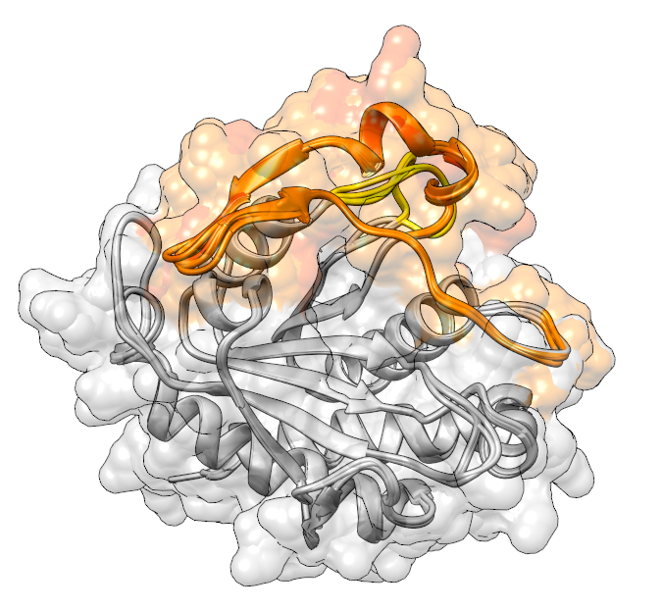
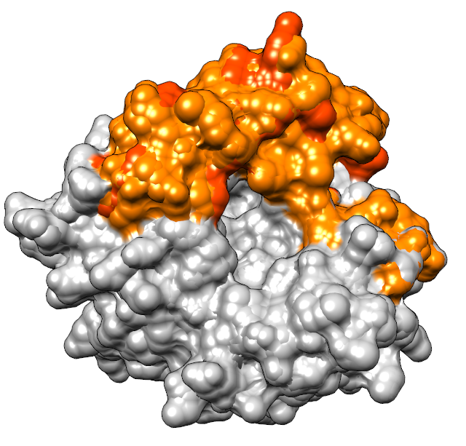
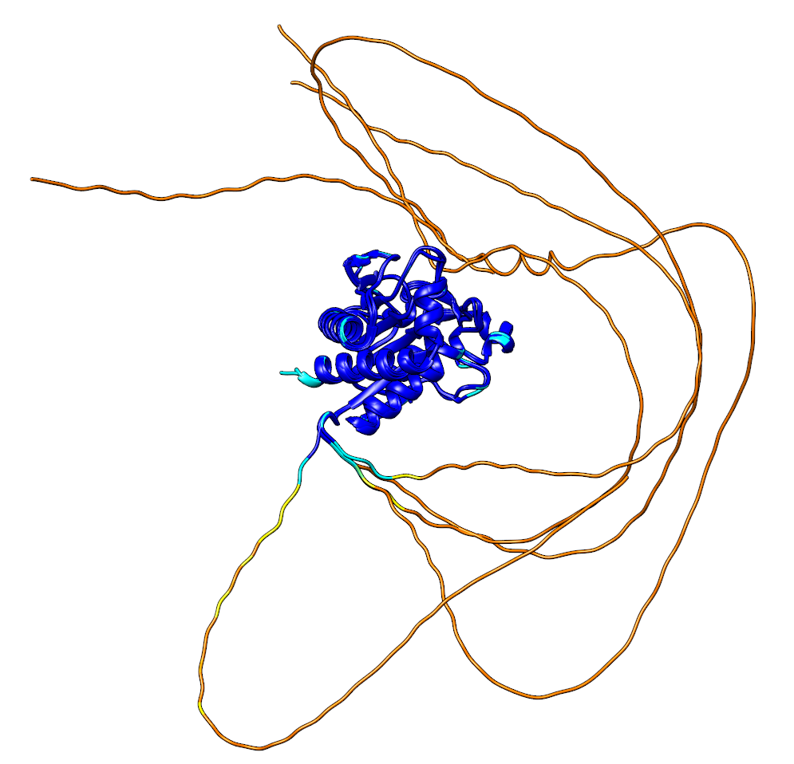
Cluster 01010000 (I-2, I-4)
The structures for these proteins notably contains the amidase_3 domain plus a long region of disorder at the N-terminus of the structure, which AlphaFold3 failed to predict structure for
I-2 corresponds to a complex loop structure around the upper edge of the active site region without blocking it, containing two beta strands which bond as the loop folds back on itself
I-4 corresponds to a short loop region which folds next to I-2
Notes:
may assist in cofactor/co-enzyme binding?

Slide 12
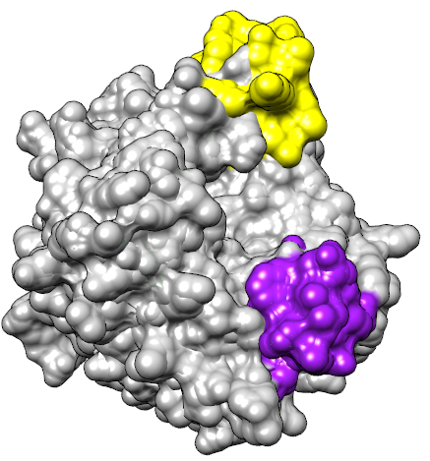
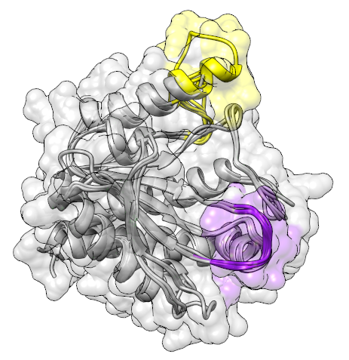
Cluster 00011000 (I-4, I-5)
When I-4 is present without I-2, the I-4 loop takes on a different position in space, looping up into the position I-2 usually takes and forming the top ‘lip’ of the active site in its place.
An additional fold possibly appears on the left of the active site, however rather than being a new insertion, this is folded from existing structure.
Notes:
may assist in cofactor/co-enzyme binding?

Slide 13
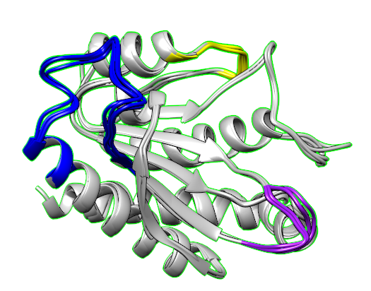
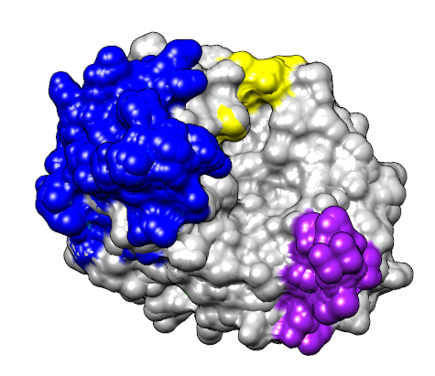
Cluster 00011100 (I-4, I-5, I-6)
When the I-6 and I-4 regions are seen together (although this not a common occurrence within the sequence dataset), the I-6 region appears in a different location.
Rather than being placed within the active site entrance and forming an alpha helix, the insertion instead folds on the exterior of the protein away from the active site, and the predicted structures do not predict the insertion to form an alpha helix.
Mostly Bacillota, and of these, most are Streptococcus species
Notes:
may assist in cofactor/co-enzyme binding?

Slide 14
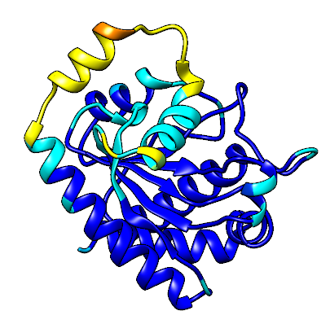
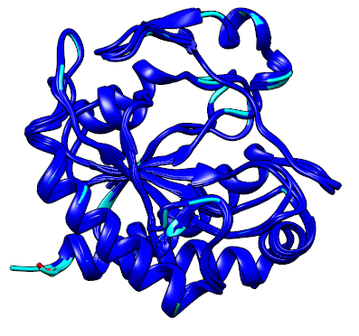
Cluster 01001110 (I-2, I-5, I-6, I-7)
Campylobacter_novaezeelandiae – example of protein structure containing both I-2 and I-6 (right)
Prediction model struggled to identify how I-2 and I-6 would fold, especially compared to the pLDDT for I-2- and I-4-containing structures.
Notes:
may assist in cofactor/co-enzyme binding?

Slide 15
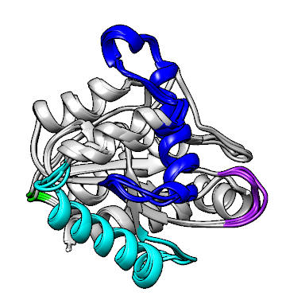
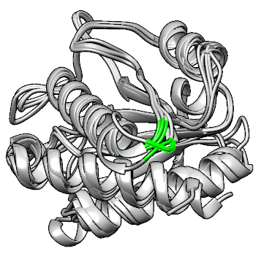
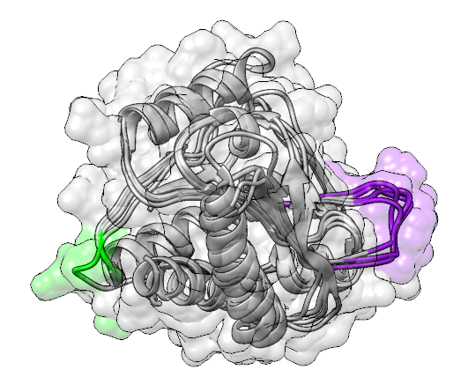
Cluster 00100000, 00101000, 00101100
I3 is the smallest predicted insertion, and corresponds to a small loop connecting an alpha helix to a single beta pleat
Given the size of this insertion and the fact that it appears to simply connect two structural components without extending far from the protein, it may be that this insertion is an artefact of the insertion identification algorithm rather than a true insertion.
This also aligns with the ‘insertion’ being present in the majority of species in the representative phylogeny, much like I-8.
Notes:
may assist in cofactor/co-enzyme binding?

